Slide 1
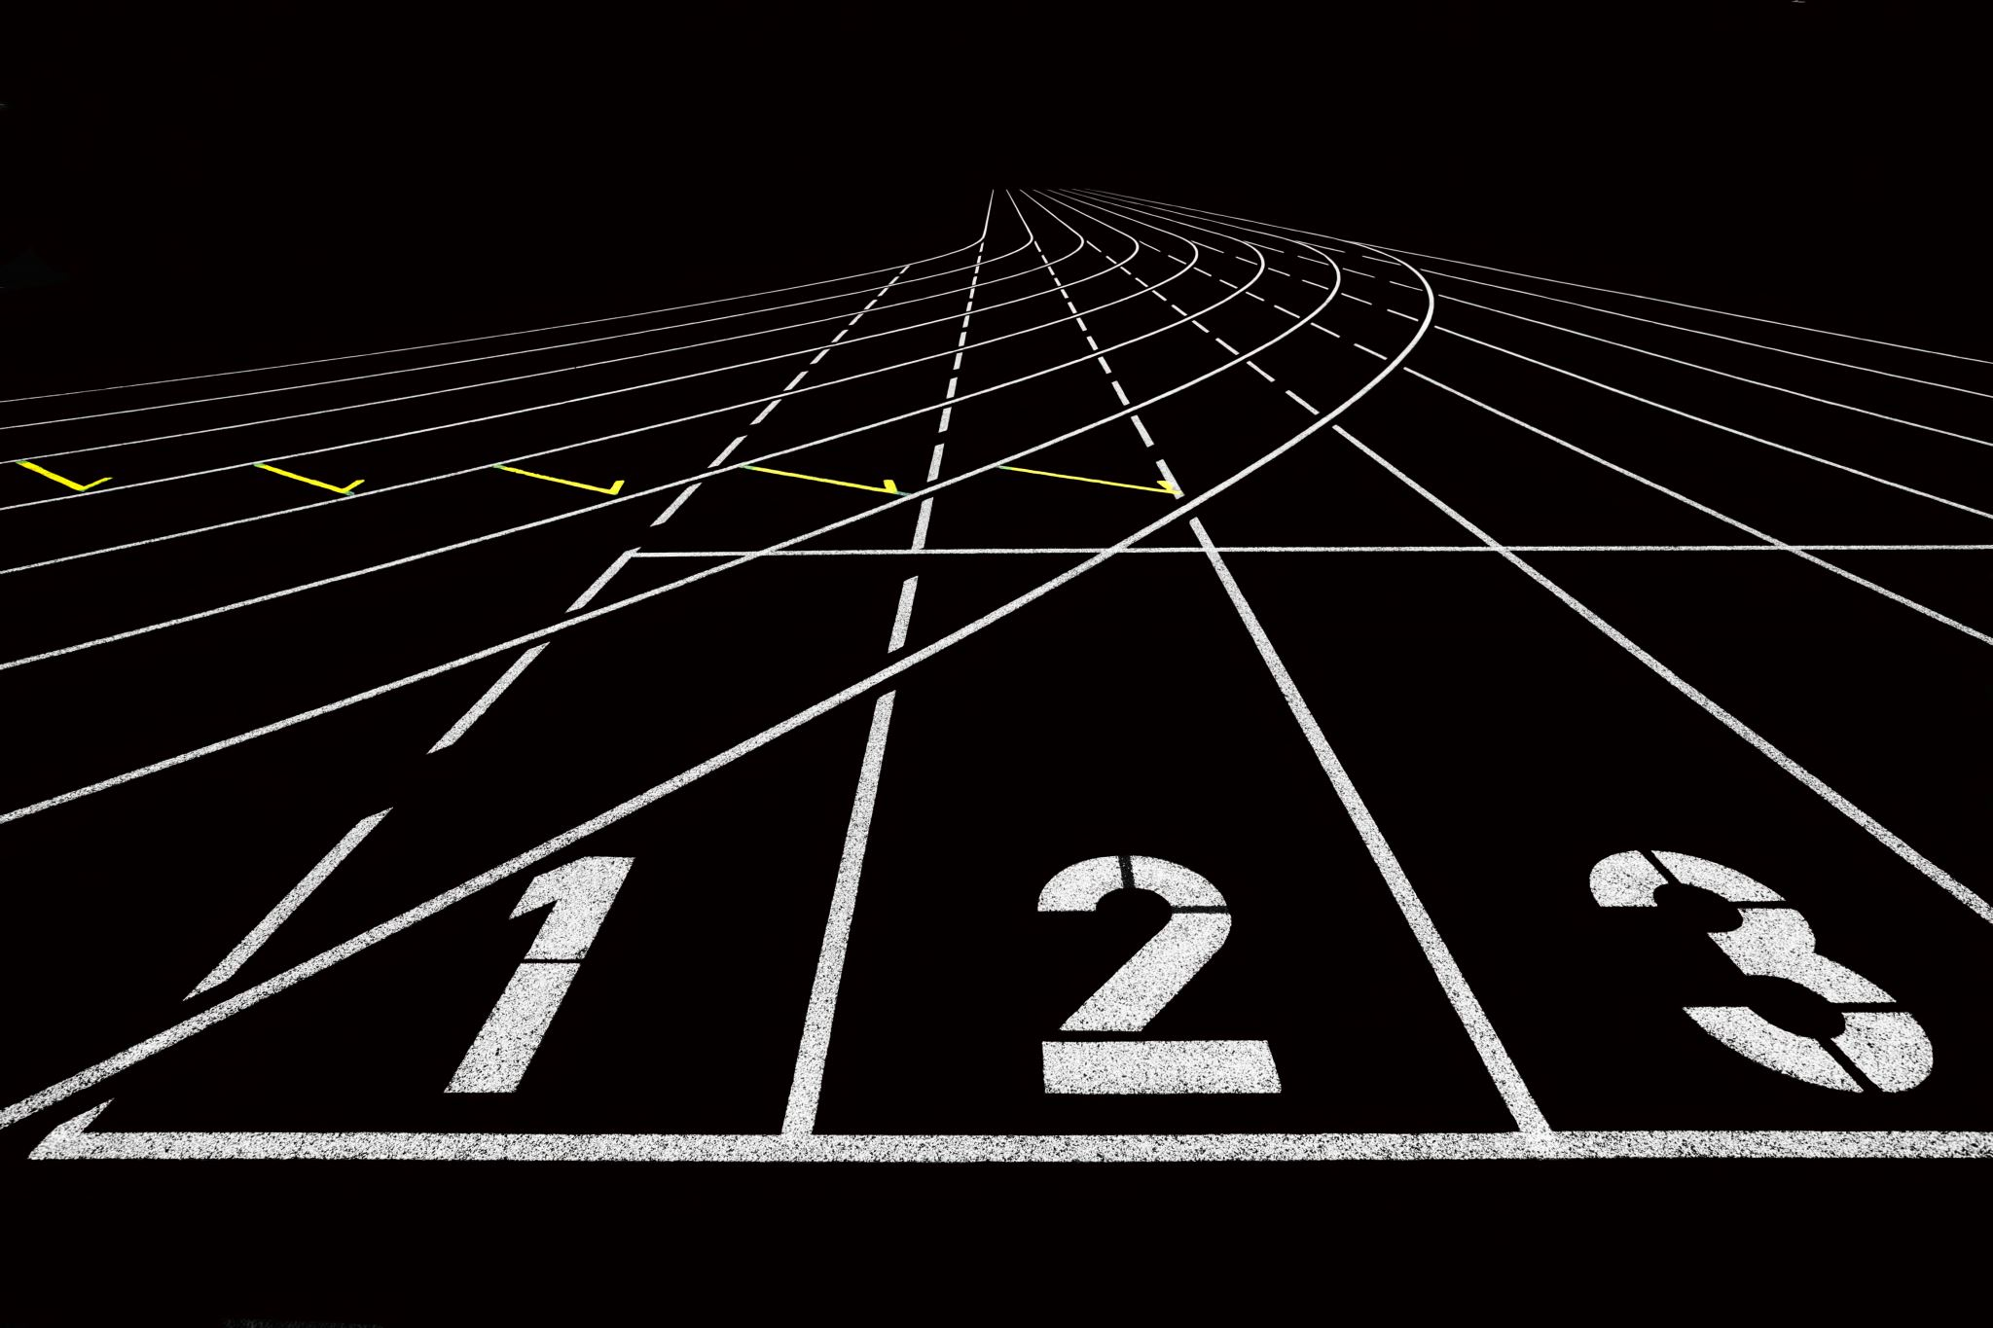
Nashville Marathon
2016-2019

Slide 2
Fastest, Slowest, and Average Times
=MIN('2016_Half'!$E:$E)

Slide 3
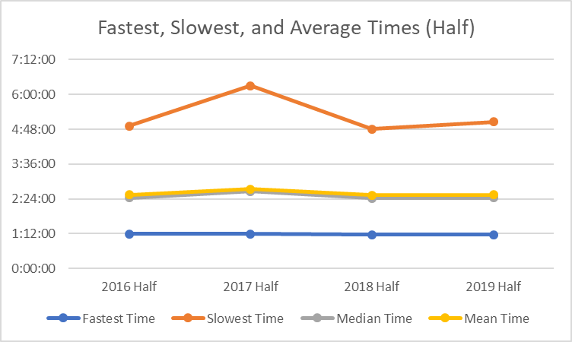
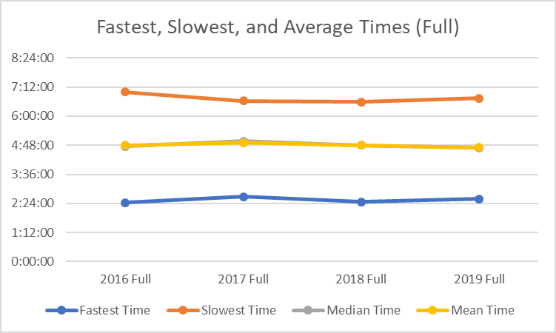
Fastest, Slowest, and Average Times

Slide 4
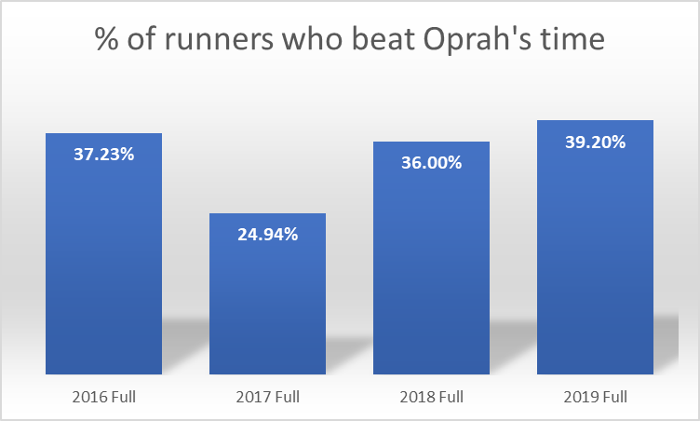
Beating Oprah
=$G2/COUNT('2016_Full'!$E:$E)
=COUNTIF('2016_Full'!$E:$E, "<04:29:20")

Slide 5
Quartiles
=QUARTILE(_2016_half_marathons[Time],1)
=MEDIAN('2016_Half'!$E:$E)
=QUARTILE(_2016_half_marathons[Time],3)

Slide 6
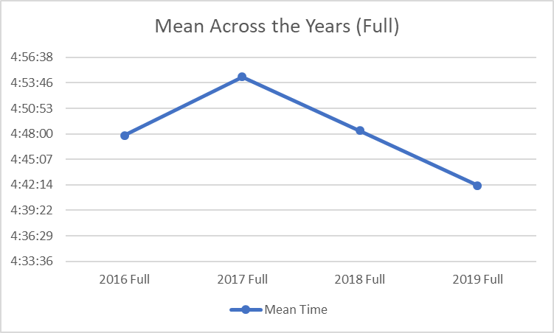
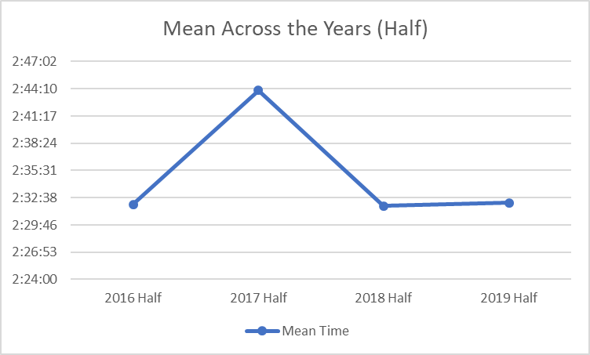
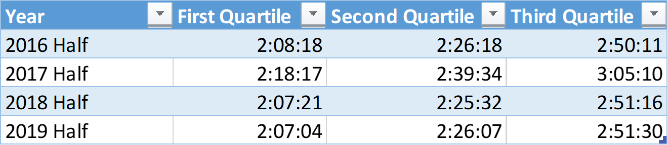
A slow year
2017 seems to have been a slow year for all racers

Slide 7
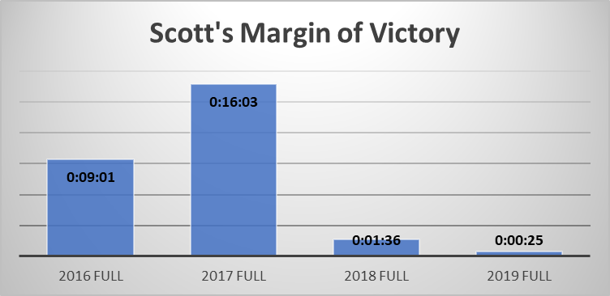
Scott’s Dominance
='2016_Full'!$E$3-'2016_Full'!$E$2

Slide 8
Top 3
='2016_Full'!$D$2

Slide 9
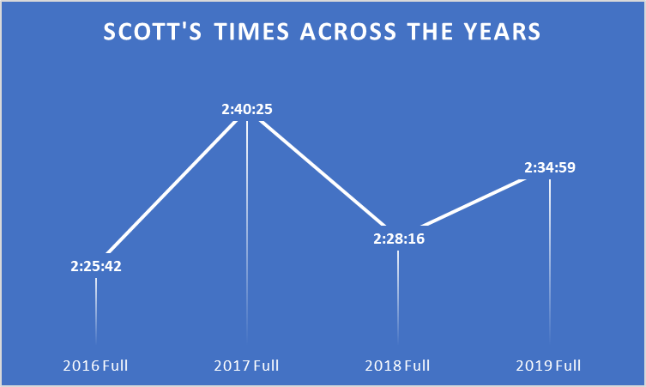
Scott’s Times Across the Years

